Slide 1


----------------
BYD Talent Initiative

Slide 2
CONTENT
About the Program
Activity Flow Chart
Gratification
Branding Opportunities
Costing
Activity Timeline
Objectives
1
2
3
4
5
6
7

Slide 3
OBJECTIVE
Nurturing Future Talent:
The GEN Z brings in Fresh talent , new perspectives, creativity, and energy.
internships help in constant upskilling, ensuring a pipeline of skilled professionals
Talent acquisition programs focus on nurturing fresh talent and providing them with exposure to real-world EV projects1.
Strategic Industry Tie-Ups:
Collaborative partnerships with educational institutions, research centers, and established automotive players are becoming essential. These tie-ups provide access to a broader talent pool and facilitate knowledge exchange between academia and industry1.
Fostering Innovation:
By engaging students, companies encourage innovation and research in EV-related fields. Students contribute fresh ideas, participate in hackathons, and work on cutting-edge projects, driving technological advancements in the EV sector1.
Creating a Sustainable Talent Pipeline:
Companies recognize that today’s students are tomorrow’s professionals. By nurturing their interest in EVs early on, organizations ensure a steady supply of skilled engineers, data scientists, and other specialists as the industry continues to grow

Slide 4
ABOUT THE PROGRAM
Program Name: EV Technology - Talent Initiative
Target Audience
IITs
BITS
IIIT
NSIT – Delhi
Focus Areas
To build Awareness on benefits of electric vehicles
Run a campaign that tracks vehicle pollution and share data for a specified period
Drive social messages around vehicle pollution, scrappage of old vehicles and tracking emission
Focus on reaffirming the need for Sustainable Electric Mobility
Propose a EV prototype which helps in sustainable environment
Help implement ‘remote sensing’ in select model city and extend it to other key cities like NCR - Tie-up with engineering colloeges & State Government
4

Slide 5
Activity Flow Chart
Plan : In this activity BYD will be collaborating with 5 top rated institute
Selection Process
1
Level 1 – EV Quiz Competition Approx 20 Ques. with 2-3 BYD related Ques. (It will be open for all streams students)
Hoping approximate 600 Students from each Institute (3000 Students)
Participants who give Correct & Quickest answers will move to L2 in a team of 4. (10 Teams from Each Institute)
Level 2 – Digital Prototype (10 Teams of 4 person each will be selected for this round)
Total 50 Teams from 5 Institute will compete in 2nd Level. Where 3 Jury will be shortlisting 10 teams from 5 institute for next level on the basis of their digital prototype.
2
10 Team from each Institute will be selected for this round
3
Level 3 – Prototype creation with sales presentation
Total 2 Teams from each Institute will be selected
In Level 3 Total 10 teams will be competing and their final prototype will be judged by 4 jury along with the sales presentation
4
3 Winning teams will be selected
3 winners will be selected
3 Team (12 Students) will be selected as winners on the basis of their prototype & Sales Presentation.

Slide 6
LEVEL OF GRATIFICATIONS
01
Digital Certification
Each and every participants will get a Digital certificate by BYD for Participating in the contest.
02
Trophy & Certificates
Total 3 teams will be selected as winners and each team will get one trophy from BYD.
Each student will get a certificate according to their position.
03
Cash Prize
Winning Team will get a amount of 2 Lakh rupees (50K each)
1st runner up team will get a amount of 1.20 Lakh (30K each)
2nd runner up team will get a amount of 1 Lakh (25K each)
04
1 Week Trip to China
Only the Winning team (Total 4 Students) will get a chance to visit China & BYD Head Quarter for 1 week.

Slide 7
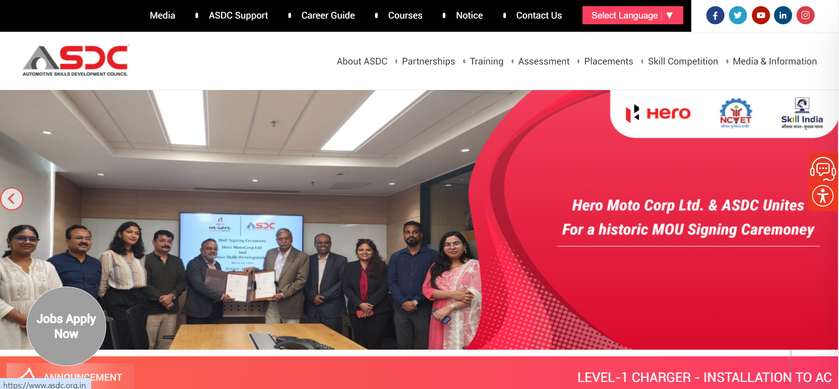
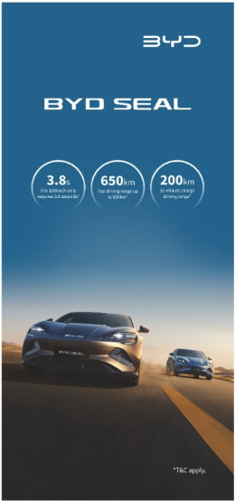
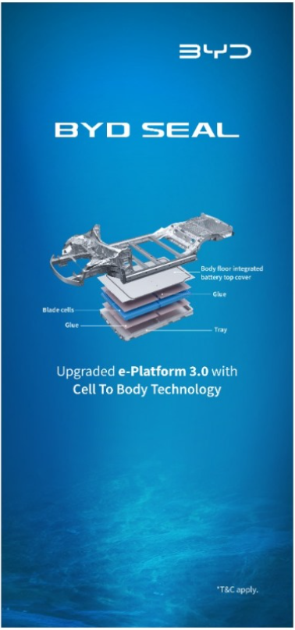
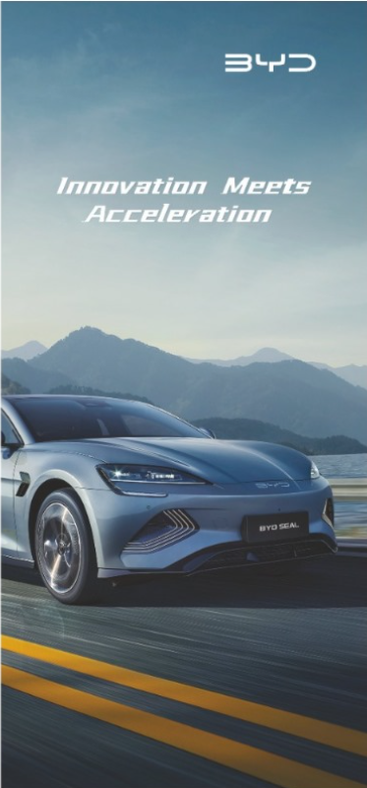
Branding Opportunities
ASDC will be putting a BYD Collaboration contest banner on their official website to increase the contest reach.
BYD will be placing standees in all the institute at different locations where the contest will get conducted to increase the participation and brand recall.
The contest will be covered extensively on our digital platforms (Facebook, Instagram, Linkedin) to increase the awareness as well as the engagement.
ASDC will also be promoting the contest on their social media platforms (Facebook, Instagram, Linkedin, Twitter)

Slide 8
Costing

Slide 9
Activity Timeline
Concept Sharing
4th Meeting with ASDC
Start of Level 2
Did a meeting with ASDC and shared the concept and all the details regarding the activity
Had a detailed discussion with ASDC regarding the approach of the contest, college shortlisting and execution of the contest.
Level 2 of the contest (Digital prototype) will start in June 2024 – July 2024 & winners will be selected for next round.
Jan
2024
May
2024
September
2024
December
2023
April
2024
June
2024
College Shortlisting & Contest Starting
Final Result
Plan shared to Mr. Liu
Final round will start in Mid July and the final result will be announced in September along with the press release.
concept presentation of the activity was shared to Mr. Liu and In principle approval was given.
ASDC & BYD present concept to Engineering Colleges (Campus visits) &
Shortlisting 5 colleges to start the Level 1 of the contest.
Press release to announce the program & objective
The project will see different selection & elimination rounds with various students participating
It will be a long term property association which will be owned by BYD
Continuous intervention of BYD technical team & marketing team to guide the students

Slide 10
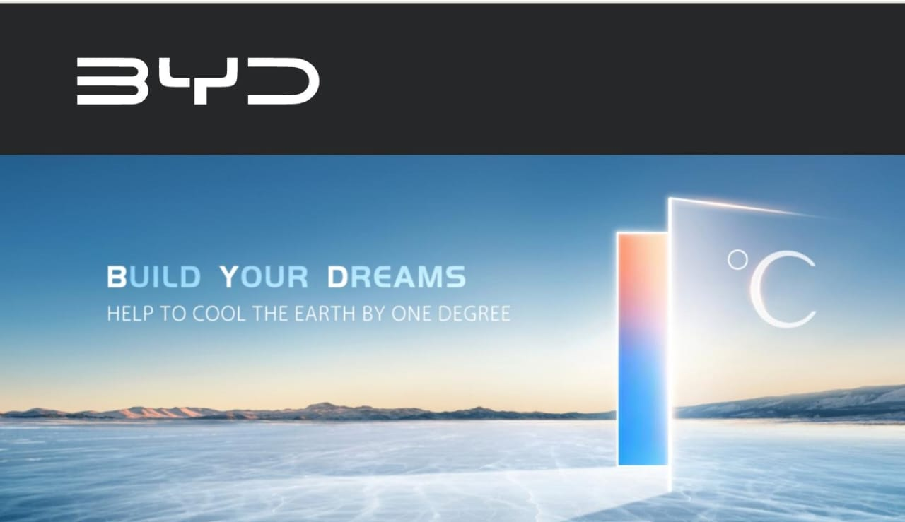
Thank you!

